Slide 1
Improving Algebraic Reasoning in Middle School
Professional Development
Presented by Instructional Research Group

Slide 2
Disclaimer
The contents of this presentation were developed under a cooperative agreement with the U.S. Department of Education, Office of Special Education Programs (PR Award # H326M170003). However, those contents do not necessarily represent the policy of the Department of Education, and you should not assume endorsement by the Federal Government. Tina Diamond, Ph.D. served as the project officer. This product is in the public domain. Authorization to reproduce it in whole or in part is granted. While permission to reprint this publication is not necessary, the citation should be:
Title of the Project. (date). Title of the document, Location of the Project, Author(s).
Furthermore, this presentation contains information from other public and private organizations that may be useful to the reader; these materials are merely examples of resources that may be available. Inclusion of this information does not constitute an endorsement by the U.S. Department of Education of any products or services offered or views expressed. This publication also contains hyperlinks and URLs created and maintained by outside organizations and provided for the reader's convenience. The Department is not responsible for the accuracy of this information.

Slide 3
Purpose & Overview
Definition & Importance of Algebraic Reasoning
Skills for Algebra

Slide 4
Standards & Content That Address Algebraic Reasoning
CCSS Standards Domains
Mathematics Content
Expressions & Equations (6, 7, 8)
Number System (6, 7, 8)
Ratios & Proportional Relationships (6, 7)
Functions (8)
Fractions/Decimals (Rational Numbers)
Ratios & Proportions
Positive & Negative Integers

Slide 5
Instructional Approaches That Support Students With Mathematics Difficulties
Evidence-Based Practices
Mathematical language
Manipulatives & representations
Think-alouds & student explanations
Reversibility, Flexibility, Generalization (RFG) framework
Other instructional supports
Co-teaching
Coaching

Slide 6
What Is Algebraic Reasoning And Why Is It Important?
“Forming generalizations from experiences with number and computation, formalizing these ideas with the use of a meaningful symbol system, and exploring the concepts of pattern and function.”
Helps students transition from arithmetic to algebra
Deepens their understanding of the concepts they are learning
Helps them see underlying problem structure, relationships and patterns, and formulate generalizations
Moves beyond the application of a formula, or mechanically going through the steps to solve a problem

Slide 7
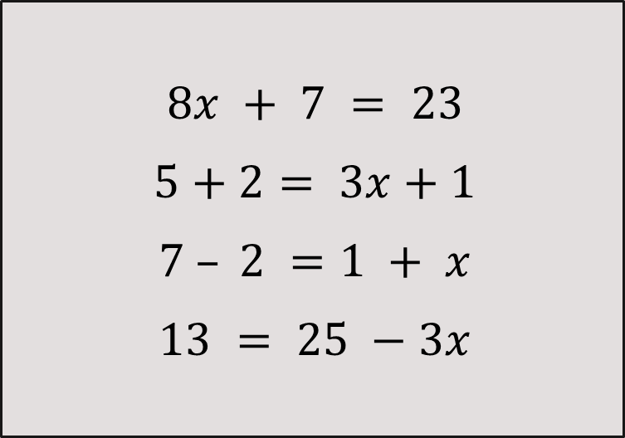
Critical Understandings For Algebra
Understanding the Meaning of the Equal Sign
$$8x + 7 = 23$$
$$5+2= 3x+1$$
$$7 – 2 =1 + x$$
$$13 = 25 −3x$$
“the same as”
Relational, not operational
Emphasis on the idea that “this side is the same as that side”

Slide 8
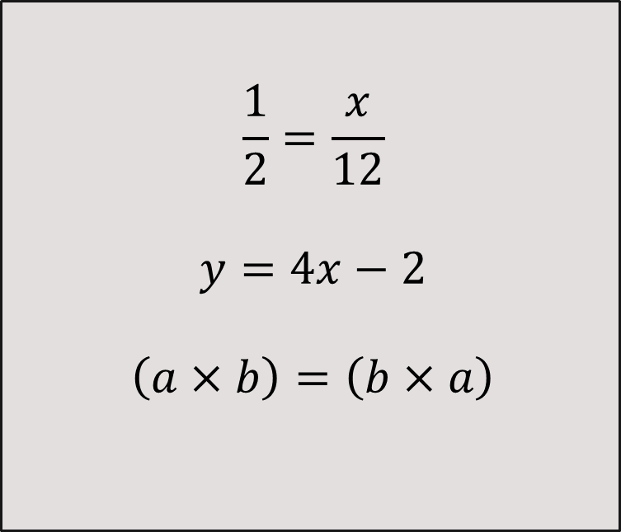
Critical Understandings For Algebra
Understanding the Meaning of a Variable
$$\frac{1}{2}=\frac{x}{12}$$
$$y=4x−2$$
$$\left(a×b\right)=\left(b×a\right)$$
One unknown; find 𝑥
Number that can vary; in a function table; shows a pattern (one input and one output)
Can express a generalization, like the commutative property

Slide 9
Successful Entry Into Algebra
Conceptual Understanding
Foundation building starts with basic number sense, progresses to rational numbers, and moves to algebraic ideas.
Fluency
Because students have mastered building blocks, they become fluent in key math concepts, allowing them to grasp the next concept.
Proficiency
Once students are fluent, automaticity results in proficiency in key math concepts, enabling success in Algebra.

Slide 10
References
Woodward, J., & Stroh, M. (2015). TransMath: Fluency with rational numbers (3rd ed.). Dallas, TX: Voyager Sopris Learning.

